Slide 1

Bristol Medical School
Systematic Reviews
Searching for Studies
Sarah Dawson
(sarah.dawson@bristol.ac.uk)

Slide 2

What is a systematic review?
A systematic review is
a review of a clearly formulated question
using systematic and reproducible methods
to identify, select and
critically appraise all
relevant research,
and to extract and analyse
data from the studies
that are included in the
review.

Slide 3
What is a systematic review?
A systematic review is
a review of a clearly formulated question
using systematic and reproducible methods
to identify, select and
critically appraise all
relevant research,
and to extract and analyse
data from the studies
that are included in the
review.
Need to know what you are looking for and where to find it…

Slide 4
Clearly formulated question
framing the research question is a critical step
mnemonics can helps focus the research question into key concepts, e.g. PICO
  Population: patient population, disease or condition
  Intervention: type of intervention or exposure
  Comparison: risk or treatment; placebo or other active treatment
  Outcome: frequency, risk, benefit, harm; dichotomous or continuous;
  mortality, morbidity, quality of life
facilitates identifying keywords/synonyms, which you can organise by concept
if the question is too vague/complex consider other types of review (first)
Sutton A, Clowes M, Preston L, Booth A. Meeting the review family: exploring review types and associated information retrieval requirements. Health Info Libr J. 2019 Sep;36(3):202-222. doi: 10.1111/hir.12276. PMID: 31541534.
Notes:
A systematic search can best be applied to a well-defined and precise research or clinical question. Questions that are too broad or too vague cannot be answered easily in a systematic way.

Slide 5
Publication bias - a type of reporting bias
The publication or non-publication of research findings, depending on the nature and direction of the results
Studies with significant, positive results are more likely to get published:
  time lag bias – more rapidly
  language bias – in English language journals
  multiple publication bias – more than once
  easier to find – indexed in major databases (location bias)
  citation bias – cited more frequently, easier to find
  under reporting of less significant or negative results
  https://methods.cochrane.org/bias/reporting-biases

Slide 6
Importance of identifying all relevant studies
Integrity - results/conclusions of review
Limiting reporting biases (un-reporting bias)
Identification depends on:
  publication
  registration
  sensitivity of search query
  sources searched
  other methods of information retrieval
Example: Tamiflu
https://www.bmj.com/tamiflu

Slide 7
Reducing reporting biases: sources searched
Search query: comprehensive, ‘sensitive’, repeatable
Search multiple sources
For published studies:
  key international bibliographic databases
  (public health is multidisciplinary: medicine/social sciences)
  topic/country specific databases (e.g. LMIC)
  handsearching
  sources of grey literature (reports, regulatory documents)
Unpublished (non-reported) studies:
  trial registers, contacting trialists
Other: screening reference lists, citation searching…‘snowballing’

Slide 8


Types of research literature
journal articles
conference proceedings
book chapters
theses & dissertations
reports
guidelines
unpublished data
results table
letter
Effects of micronutrients supplementation on infectious morbidity in young children in Burkina Faso
By
Jerome Winbetourefa Some
M.D. (Universite de Ouagadougou, Burkina Faso) 2009
DISSERTATION
Submitted in partial satisfaction of the requirements for the degree of
DOCTOR OF PHILOSOPHY
in
Nutritional Biology
in the
OFFICE OF GRADUATE STUDIES
of the
UNIVERSITY OF CALIFORNIA
DAVIS
Approved
Kenneth H. Brown, Chair
Bo L. Lonnerdal
Danielle J. Harvey
Committee in charge
2015

Slide 9
Where to find research literature/data
REFERENCES
Lassi ZS, Moin A, Bhutta ZA. Zinc supplementation for the prevention of pneumonia in children aged 2 months to 59 months. Cochrane Database Syst Rev 2016;12:CD005978. 10.1002/14651858.CD005978.pub3 [PMC free article] [PubMed] [CrossRef] [Google Scholar]
Tie HT, Tan Q, Luo MZ, et al. . Zinc as an adjunct to antibiotics for the treatment of severe pneumonia in children <5 years: a meta-analysis of randomised-controlled trials. Br J Nutr 2016;115:807–16. 10.1017/S0007114515005449 [PubMed] [CrossRef] [Google Scholar]
Sempértegui F, Estrella B, Rodríguez O, et al. . Zinc as an adjunct to the treatment of severe pneumonia in Ecuadorian children: a randomized controlled trial. Am J Clin Nutr 2014;99:497–505. 10.3945/ajcn.113.067892 [PubMed] [CrossRef] [Google Scholar]
UN Inter-agency Group for Child Mortality Estimation. Levels & Trends in Child Mortality. 2015. Available: https://data.unicef.org/wp-content/uploads/2015/12/IGME-report-2015-child-mortality-final_236.pdf. Accessed: 29 November 2016.
UN Inter-agency Group for Child Mortality Estimation. Cause of Death Data 2015. 2015. Available: https://data.unicef.org/topic/child-survival/under-five-mortality. Accessed: 29 November 2016.
Jaffar S, Leach A, Greenwood A. Changes in the pattern of infant and childhood mortality in Upper River Division, The Gambia, from 1989 to 1993. Trop Med Int Health. 1997;2:28–37. doi: 10.1046/j.1365-3156.1997.d01-131.x. [PubMed] [CrossRef] [Google Scholar]
Greenwood BM, Greenwood AM, Bradley AK, Tulloch S, Hayes R, Oldfield FS. Deaths in infancy and early childhood in a well-vaccinated, rural, West African population. Ann Trop Paediatr. 1987;7:91–9. doi: 10.1080/02724936.1987.11748482. [PubMed] [CrossRef] [Google Scholar]
bibliographic databases
theses databases
trial registers
other systematic reviews
scanning reference lists/
related references
citation searching
grey literature (websites)
organisation web sites
contacting key authors/
trialists

Slide 10

Bibliographic databases
Key to successful information retrieval is to recognize that, on the whole, you are searching a short summary, a bibliographic record (title, abstract, keywords) NOT the full-text article
Authors: Howie S, Bottomley C, Chimah O et al
Article Title: Zinc as an adjunct therapy in the management of severe pneumonia among Gambian children: randomized controlled trial
Source: Journal of Global Health
Abstract: We assessed the benefit of adjunct zinc therapy for severe pneumonia in children …. This was a randomized, parallel group, double-blind, placebo-controlled trial …
Subject Headings (MeSH): *Child; Double-Blind Method; Adjuvants, Pharmaceutic / tu [Therapeutic Use]; Gambia; *Pneumonia/dt [Drug Therapy]; *Zinc/df [Deficiency]; *Zinc/tu [Therapeutic Use]
Publication Type: Journal Article. Randomized Controlled Trial
Trial ID: ISRCTN33548493

Slide 11
Bibliographic databases
Some records may have no abstract!
Authors: Folwaczny, C
Article Title: [Role of zinc in treatment of acute diarrhea]. [German]
Original Title: Die Rolle von Zink in der Behandlung der akuten Diarrhoe
Source: Zeitschrift fur Gastroenterologie
Abstract:
Author Assigned Keywords: -
Subject Headings (MeSH): Child, Preschool; *Developing Countries; *Diarrhea, Infantile /dt [Drug Therapy]; Double-Blind Method; India; Infant
*Zinc / ad [Administration & Dosage]
Publication Type: Randomized Controlled Trial

Slide 12
Bibliographic databases
use text words (keywords in the title/abstract of a record) [.tw.]
[sometimes this is displayed as .ti,ab.]
for text words use: synonyms, variant spellings, truncation, proximity operators etc
use Subject Headings too MeSH (MEDLINE); EMTREE (Embase)
consider other search fields e.g. ‘Publication Type’ [pt], author assigned keywords [kf,kw]

Slide 13
Search Syntax (for text words)
Use truncation to find singular/plural word forms & variant word endings
  * (asterisk) replaces zero or many characters at the end of a word (stemming)
  child* will find child, children, childhood, childcare, etc.
  Use wildcards to find variant word forms, US/UK spelling
  # replaces one character within a word
  randomi#ed will find randomised or randomized
  ? replaces zero or one characters within a word
  p?ediatrics will find paediatrics or pediatrics

Slide 14
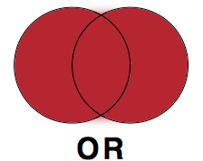
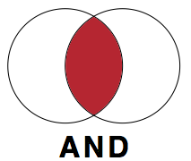
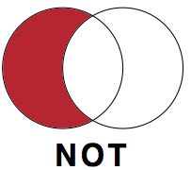
Boolean operators
use OR to combine terms (text words, subject headings) for the same concept e.g. (child* OR infant* OR schoolchild*)
use AND to combine terms for two or more concepts
e.g. (child* or infant* or schoolchild*) AND (zinc or iron)
NB Brackets are important when using two (or more) search operators, make sure to nest each set of terms within brackets
use NOT to remove a concept (caution)
e.g. humans NOT animals

Slide 15
Other search operators – adjacency
use ADJn to locate terms within n words of each other in either direction, in a sentence or in a paragraph
(diet* supplement*) will only find:
‘dietary supplements’ or ‘diets supplemented with’ etc
[i.e. permutations of these words, next to each and in this order]
**************
(diet* ADJ3 suppl*) will also find:
‘supplementing diets with’
‘dietary micronutrient supplementation’
‘diets which are supplemented’ etc

Slide 16
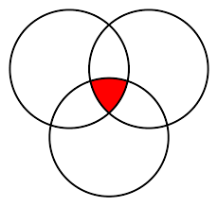
Combining search terms: Boolean Logic
Set-1 (Population)
1. exp CHILD/
2. exp INFANT/
3. (child* or boys or girls or infant* or juvenil* or minors or p?ediatric* or school* or preschool* or pre-school*).tw.
4. OR/1-3
Set-2 (Intervention)
5. exp ZINC/
6. exp ZINC COMPOUNDS/
7. DIETARY SUPPLEMENTS/
8. ((zinc or iron) and (supplement or fortif*)).tw.
10. (diet* adj3 supplement*).tw.
11. OR/5-10
Set-3 (Study Design Filter)
12. randomized controlled trial.pt.
13. controlled clinical trial.pt.
14. (RCT or cRCT or randomiz* or randomis*).tw.
15. or/12-14
[N.B. Other more sensitive RCT filters available!]
Combine: Condition + Intervention + RCTs
16. (4 and 11 and 15)

Slide 17

Searching is a balancing act
Set-1 (Population)
1. exp CHILD/
2. exp INFANT/
3. (child* or boys or girls or infant* or juvenil* or minors or p?ediatric* or school* or preschool* or pre-school*).tw.
4. OR/1-3
Set-2 (Intervention)
5. exp ZINC/
6. exp ZINC COMPOUNDS/
7. DIETARY SUPPLEMENTS/
8. ((zinc or iron) and (supplement or fortif*)).tw.
10. (diet* adj4 supplement*).tw.
11. OR/5-10
Set-3 (Study Design Filter)
12. randomized controlled trial.pt.
13. controlled clinical trial.pt.
14. (RCT or cRCT or randomiz* or randomis*).tw.
15. or/12-14
[N.B. Other more sensitive RCT filters available!]
Combine: Condition + Intervention + RCTs
16. (4 and 11 and 15)

Slide 18


Sensitivity vs Specificity
balance sensitivity and specificity
  SENSITIVITY (recall) - capturing all relevant records
  SPECIFICITY (precision) - eliminating irrelevant hits
aim for high recall and low precision
************************

Slide 19
Search terms
to capture all relevant records, search for all possible variations of a word or phrase e.g. if population = children/adolescents try:
Sensitive search
(child* or boy* or girl* or infant* or juvenil* or minors or paediatric* or pediatric* or school* or preschool or pre-school* or kindergarten or nursery or adolesc* or preadolesc* or pre-adolesc* or pubert* or pubescen* or prepube* or pre-pube* or high-school or teen* or young or youth* or student* or undergrad* or college or campus)
Precise search!
child* or adolesc*

Slide 20
Search filters: study design
A filter is a list (search string) of relevant subject headings and keywords used to increase the specificity of a search
e.g. limit to: systematic reviews, observational studies, RCTs, diagnostic studies, economic analyses etc
(many filters tailored for each database MEDLINE, EMBASE etc), see:
InterTASC Search Filter Resource http://www.york.ac.uk/inst/crd/intertasc/
Scottish Intercollegiate Guidelines Network
https://www.sign.ac.uk/search-filters.html
Other limits e.g. date (updating an existing review, date a drug was developed/licensed etc). Apply with caution!
Explore these later

Slide 21
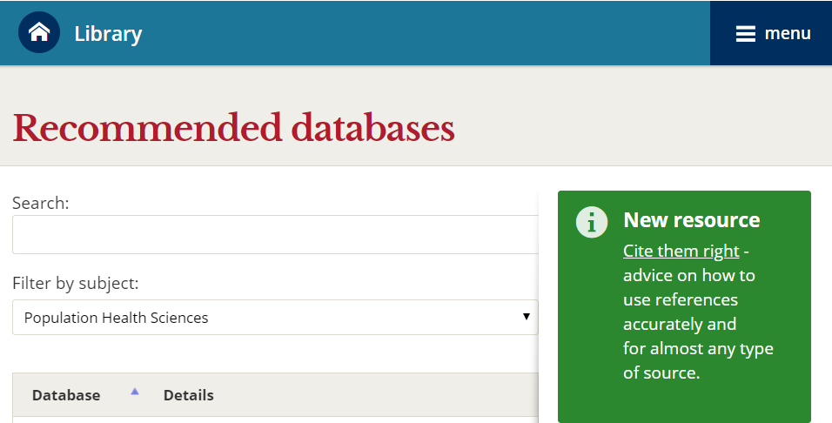
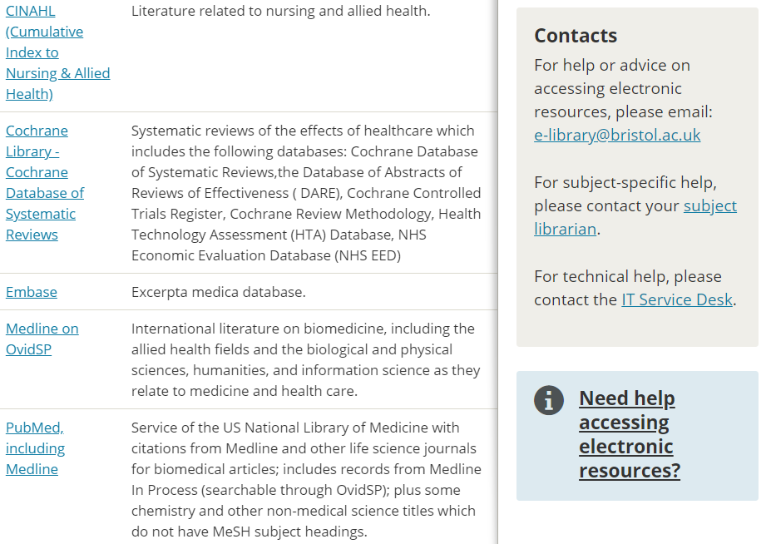
Key bibliographic databases
Search for TITLE of database or filter by SUBJECT e.g. Population Health Sciences or
Sociology or Education
Multidisciplinary nature of public health literature
http://www.bris.ac.uk/library/find/databases/

Slide 22
Key sources: bibliographic databases
Major biomedical, bibliographic databases:
MEDLINE (PubMed), Embase
Specialist databases:
  Subject specific: e.g. CINAHL, PsycINFO, ERIC, IBSS
  Citation indexes: Web of Science, Scopus
  National/regional: e.g. LILACS, SciELO
  Study Type: e.g. for RCTs use Cochrane Library Trials database
  (also known as CENTRAL)

Slide 23
Example of subscription based databases
Ovid Embase (1974 -)
Ovid MEDLINE (1946 -)
Ovid PsycINFO (1806 -)
Clarivate - Web of Science (Science (1900 - )/Social Citation Index (1956 -)
Elsevier – SCOPUS (Science/Social Science) (1800 -)
EBSCO - Cumulative Index of Nursing and Allied Health (CINAHL) (1981 - )
ProQuest - Sociological Abstracts (1952 - )
ProQuest - International Bibliography of Social Sciences (IBSS) (1951 - )
ProQuest - ERIC (Educational Resources Information Center) (1966 - )
ProQuest - Dissertations & Theses Global
http://www.bris.ac.uk/library/find/databases/

Slide 24
Other sources of trial reports
theses/dissertations (e.g. Dissertations Abstracts)
conferences (e.g. EMBASE, Web of Science)
grey literature (key reports, policy documents)
handsearching (books, journals, conference proceedings)
snowballing (reference lists, citation searching, related references)
systematic reviews, Health Technology Assessments
(e.g. Centre for Reviews and Dissemination (CRD), Cochrane Library)
contacting authors, trialists, drug companies
searching trials registries
guidelines
Objective. To identify trials which your main search may have failed to find!

Slide 25
Searching other sources – grey literature
Theses
Proquest Dissertations & Theses Global (PQDT Global) (UoB susbscription)
Electronic Theses Online Service (EThOS) - British Library
http://ethos.bl.uk/Home.do
DART - Europe e-theses Portal
http://www.dart-europe.eu/basic-search.php
Networked Digital Library of Theses and Dissertations (NDLTD)
http://search.ndltd.org/
PQDT Open - open access dissertations and theses
https://pqdtopen.proquest.com/search.html
Other
WHO Library Database (WHOLIS) – Documents and Reports
http://www.who.int/library/databases/en/
World Bank – Documents and Reports
http://documents.worldbank.org/curated/en/home
Open Grey http://www.opengrey.eu/
Google Search – limit to a particular web site e.g. type health promotion obesity site:who.int

Slide 26
Searching other sources - review databases
Cochrane Library (CDSR)
https://www.cochranelibrary.com/
NIHR Journals Library – Health Technology Assessment
https://www.journalslibrary.nihr.ac.uk/HTA/#/
Centre for Reviews and Dissemination (CRD) Databases (archived)
https://www.crd.york.ac.uk/crdweb/Homepage.asp
DoPHER (Database of promoting health effectiveness reviews)
http://eppi.ioe.ac.uk/webdatabases/Search.aspx
Epistemonikos
https://www.epistemonikos.org/
Health Evidence
https://www.healthevidence.org/
3ie International Initiative for Impact Evaluation
http://www.3ieimpact.org/en/evidence/systematic-reviews/
Free Access

Slide 27
Studies and review databases
PubMed
https://www.ncbi.nlm.nih.gov/pubmed/
Cochrane Library (Trials)
https://www.cochranelibrary.com/
Global Index Medicus
http://www.globalhealthlibrary.net/php/index.php
TRoPHI (Trials Register of Promoting Health Interventions)
https://eppi.ioe.ac.uk/webdatabases4/Intro.aspx?ID=12
TRIP medical database (Translating Research into Practice)
https://www.tripdatabase.com/
Country Specific Databases
African Index Medicus (AIM)
http://indexmedicus.afro.who.int/
IndMed
http://indmed.nic.in/
KoreaMed
https://koreamed.org/
LILACS (Latin America and the Caribbean)
http://lilacs.bvsalud.org/en/
Free Access

Slide 28
Trial Registers
Registers/Registries:
  www.anzctr.org.au
  www.clinicaltrials.gov
  www.ISRCTN.org
  www.umin.ac.jp/ctr/index/htm
  www.trialregister.nl
  www.clinicaltrialsregister.eu
  www.who.int/ictrp/en/
  (WHO International Clinical Trials Registry Platform)
Objective. To identify unpublished research.
See also: +AllTrials initiative
& FDAATrials Tracker
Free Access

Slide 29
Managing Search Results
Reference Management Software
  EndNote, Ref Works
  Citavi, Mendeley, Zotero (free online tools)
  Excel
  download records from each database searched
  remove duplicate records
  annotate records (eg ‘Research Notes’ field in EndNote)
  import/link full-text documents (eg EndNote ‘Find Full-Text’ feature)
Screening Software
  Rayyan, Covidence, EPPI Reviewer
  Access, Excel

Slide 30
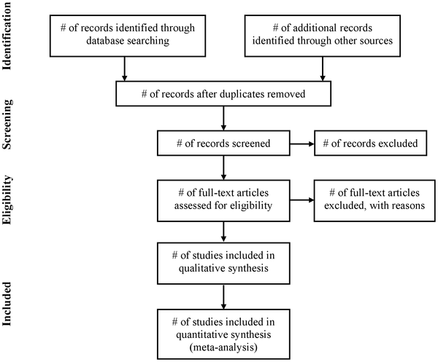
Reporting of systematic reviews
PRISMA Flow Diagram
Moher D, Liberati A, Tetzlaff J, The PRISMA Group. Preferred reporting items for systematic reviews and meta-analyses: The PRISMA Statement. PLoS Med. 2009; 6(6).
http://www.prisma-statement.org/

Slide 31
In conclusion
Database searching
  takes time - sensitive search queries, multiple sources to search
  requires clear, logical approach
  plan and document what you do
  iterative process – be reflective, make alterations, experiment
  get help from a librarian/information specialist if necessary
Keeping up-to-date
  search alerts (OVID Auto-alerts), citation alerts (Web of Knowledge)
Re-run saved searches
Records may have been added retrospectively, so search for Year and Record Entry Date
e.g. OVID MEDLINE use (2016* or 2017* or 2018*). yr,dp,dt,ep,ez
[yr:year; dp:date of publication; dt: create date; ep: electronic publication date; ez: Entrez date]

Slide 32
Further reading
Lefebvre C, Glanville J, Briscoe S, Littlewood A, Marshall C, Metzendorf M-I, Noel-Storr A, Rader T, Shokraneh F, Thomas J, Wieland LS. Chapter 4: Searching for and selecting studies. In: Higgins JPT, Thomas J, Chandler J, Cumpston M, Li T, Page MJ, Welch VA (editors). Cochrane Handbook for Systematic Reviews of Interventions version 6.1 (updated September 2020). Cochrane, 2020. Available from www.training.cochrane.org/handbook.

